Slide 1
Unit Testing FAST
Presenter: Abhijit Guha
Date: 16/07/ 2014
Document classification: Internal

Slide 2
Agenda
Challenges to implement Unit Testing in FAST.
How to overcome the challenges.
Unit testing framework and Folder structure in TFS.
Changes in BOFrame
Unit Test Base class
Guidelines to refactor existing code.
How to Unit Test Service Handlers.
Demo
How to Unit Test Bo’s?
Demo
Unit Test Guidelines for FAST.

Slide 3
Why is it so difficult to unit test FAST?
FAST is a legacy system designed and developed following classic development methodology – Code First.
Components are tightly coupled. Makes it difficult to test these components in isolation.
Business Objects are dependent on DB calls for attributes/properties exposed by them.
Lack of clean segregation of business logic among various layers.
One method doing all the business processing. These complex methods make it difficult to write test cases against them for a specific scenario. You have to have all dependent objects/data in place in order to run a specific scenario.

Slide 4
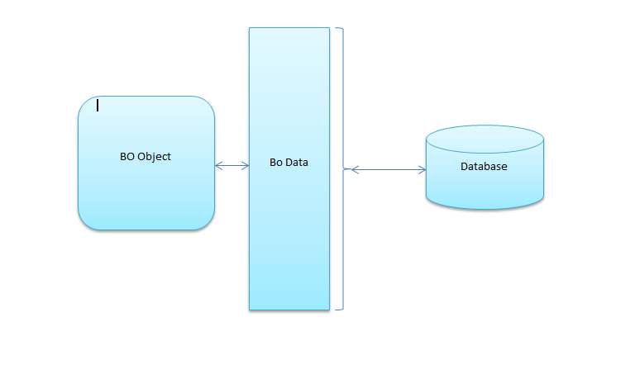
How to address it ? 1. Loose Coupling of BO and DB
Current Implementation of BOData

Slide 5
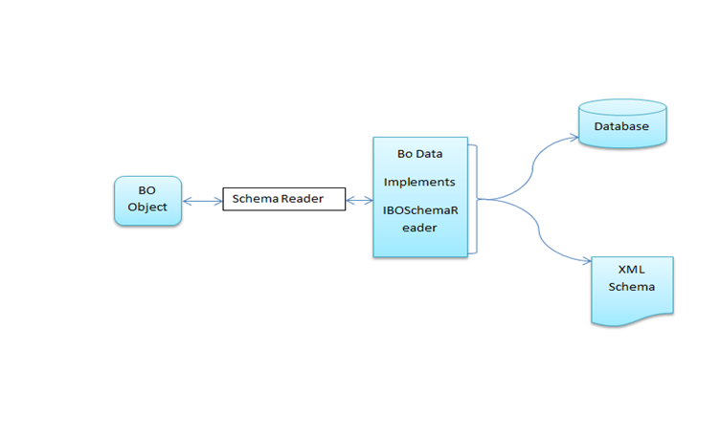
How to address it ? 1. Loose Coupling of BO and DB
Modified Implementation of BOData

Slide 6
How to address it ? 2. Refactoring existing code.
Refactoring guidelines with demo.
Segregate business logics into independent method blocks. Every method should follow single responsibility principle.
Avoid using global variables, instead pass required values as parameters to methods containing business logic.
Always pass only required information on which your method is dependent on instead of passing the whole BO objects or Schema objects wherever applicable.
If a method to be unit tested is dependent on LoadObject or LoadCollection, try to initialize the collection/ Object outside the method and pass it to the method as parameter.

Slide 7
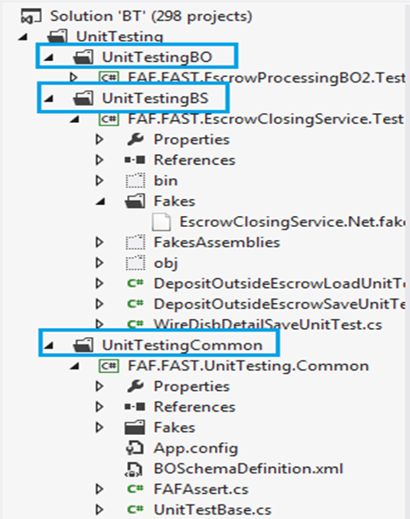
Unit Testing Framework and Folder Structure in TFS.

Slide 8
Complete Guidelines
FAST - Development Guidelines.doc

Slide 9
Samples for writing Test cases for Service Handlers With Demo
Case 1: NewObject call inside testable method.
- Will work without any issue.
Case 2: Passing BOCollection/ BOObject as method parameter.
- Create the BO Collection or Object in the test case and pass as parameter.
Case 3: LoadObject/ LoadCollection inside testable method.
- Refactor the code in such a way that the object/ collection can be passed as parameter to the actual unit testable method.
- Create a shim of the LoadObject/ LoadCollection with required data for the test case.

Slide 10
Samples for writing Test cases for Business Objects With Demo
Testing IsValid method.
Testing BeforeSave and AfterSave.

Slide 11
Questions/ Suggestions !

Slide 12
Thank You!

